Slide 1
Overfitting and Underfitting in Machine Learning
Shorouk Ahmed

Slide 2
What is Overfitting?
Overfitting happens when a model is excessively complex, capturing not just the patterns but also the noise in the training data. Identifying overfitting is a bit more nuanced:
Training Set: A model with high variance can fit the training data exceedingly well, achieving high training accuracy (e.g., 95%).
Test Set: However, this model will perform significantly worse on the test set, exhibiting lower test accuracy (e.g., 75%).
In essence, an overfit model “memorizes” the training data but struggles to generalize to new, unseen data.

Slide 3
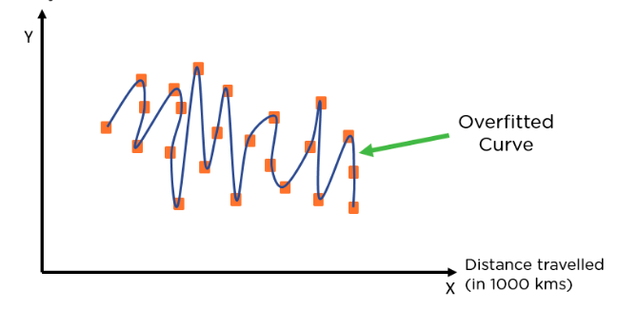

Slide 4
What is Underfitting?
Underfitting occurs when a model is too simplistic to capture the underlying patterns in the data. You can identify underfitting by analyzing the model’s performance on both the training and test datasets:
Training Set: A model with high bias will struggle to fit the training data, resulting in low training accuracy (e.g., 60%).
Test Set: The same model will also perform poorly on the test set, leading to low test accuracy (e.g., 65%).

Slide 5
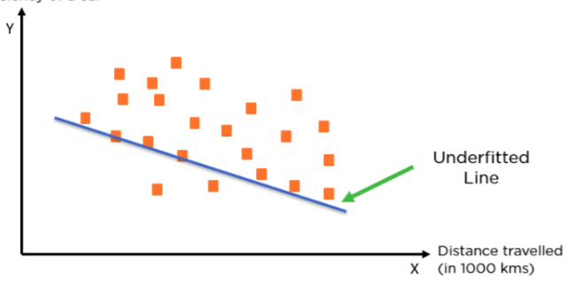

Slide 6
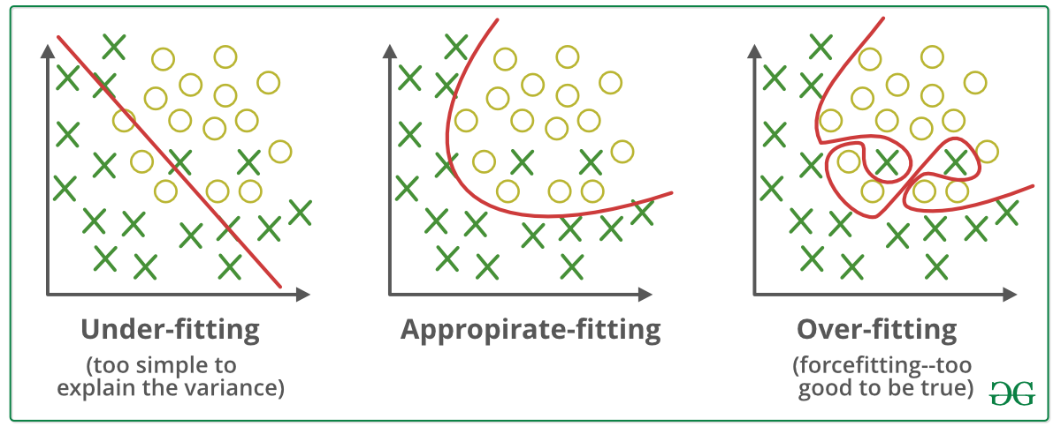

Slide 7
Examples
• Overfitting: High training accuracy, low test accuracy
• Underfitting: Low training accuracy, low test accuracy

Slide 8
Causes of Overfitting
• Too complex models
• Insufficient training data
• Noisy data

Slide 9
Causes of Underfitting
Too simple models
Model complexity
Insufficient training time
Insufficient data
Inadequate features

Slide 10
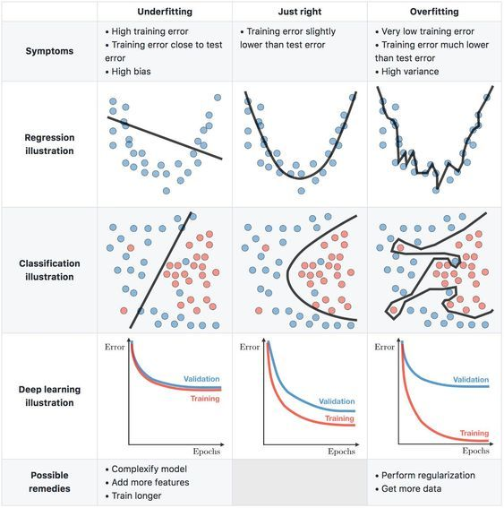

Slide 11
What are Bias and Variance?
Bias :is the difference between the average prediction of our model and the correct value which we are trying to predict. A model with high bias pays very little attention to the training data and oversimplifies the model.
Variance :is the variability of model prediction for a given data point or a value that tells us the spread of our data. A model with high variance pays a lot of attention to training data and does not generalize on the data which it hasn’t seen before.

Slide 12
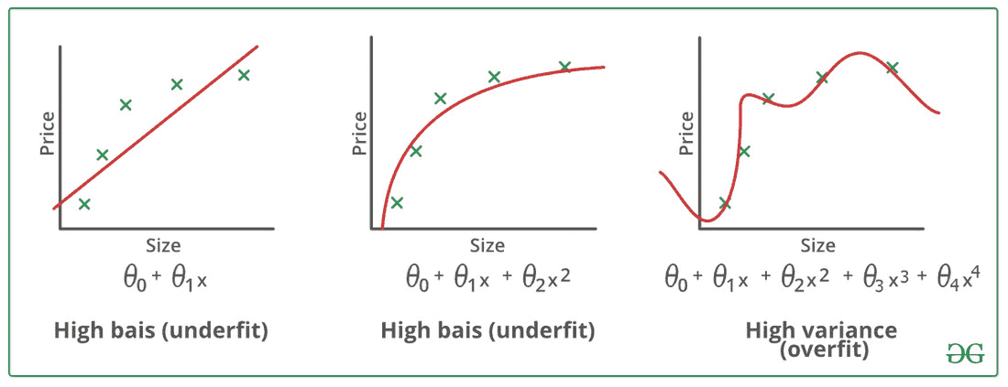

Slide 13
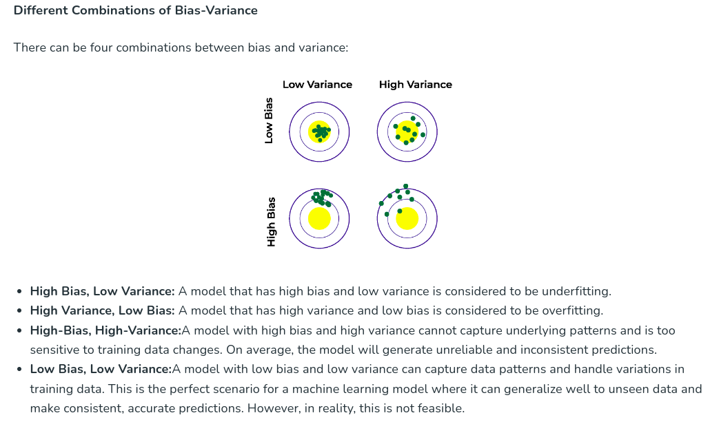

Slide 14
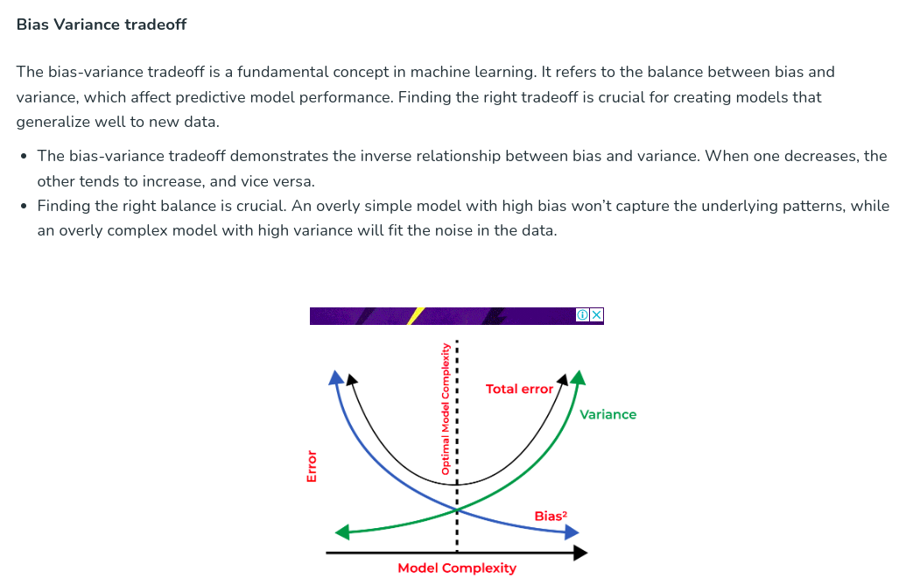

Slide 15
Techniques to Prevent Overfitting
Cross-Validation: Explain k-fold cross-validation
Regularization: Explain L1 and L2 regularization
Early Stopping: During training of neural networks
Dropout: In neural networks
Ensembling: Combining multiple models

Slide 16
Cross-Validation
Cross-validation is a technique used to evaluate the performance of a machine learning model by partitioning the data into subsets and using these subsets to test and train the model. It helps in understanding how well the model generalizes to new, unseen data.
What is cross-validation used for?
The main purpose of cross validation is to prevent overfitting, which occurs when a model is trained too well on the training data and performs poorly on new, unseen data. By evaluating the model on multiple validation sets, cross validation provides a more realistic estimate of the model’s generalization performance, i.e., its ability to perform well on new, unseen data.

Slide 17


Slide 18
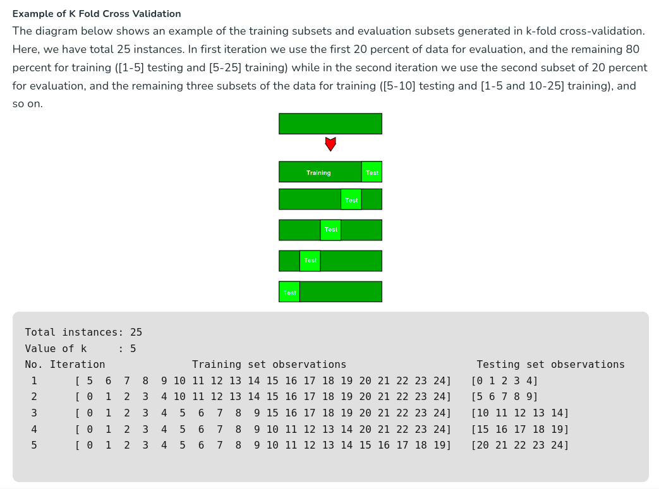

Slide 19
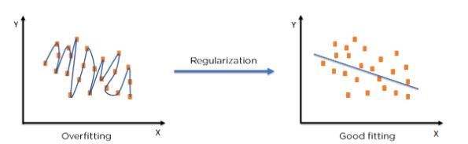
Regularization
Regularization is a technique used to prevent overfitting by adding a penalty term to the loss function,

Slide 20
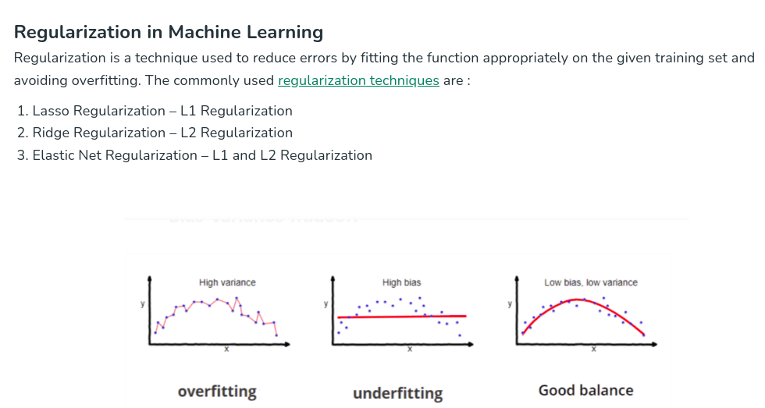

Slide 21
L1 Regularization (Lasso):
L2 Regularization (Ridge):
A regression model which uses the L1 Regularization technique is called LASSO(Least Absolute Shrinkage and Selection Operator) regression. Lasso Regression adds the “absolute value of magnitude” of the coefficient as a penalty term to the loss function(L). Lasso regression also helps us achieve feature selection by penalizing the weights to approximately equal to zero if that feature does not serve any purpose in the model.
A regression model that uses the L2 regularization technique is called Ridge regression. Ridge regression adds the “squared magnitude” of the coefficient as a penalty term to the loss function(L).

Slide 22
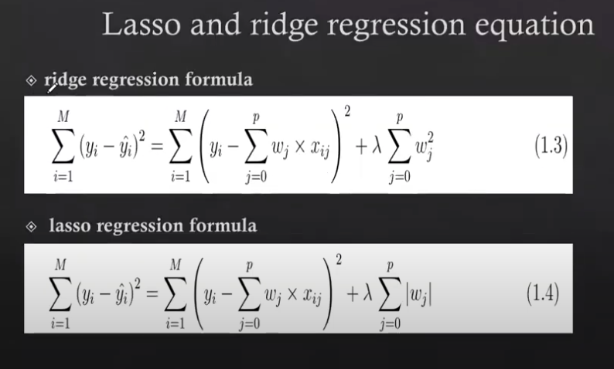

Slide 23
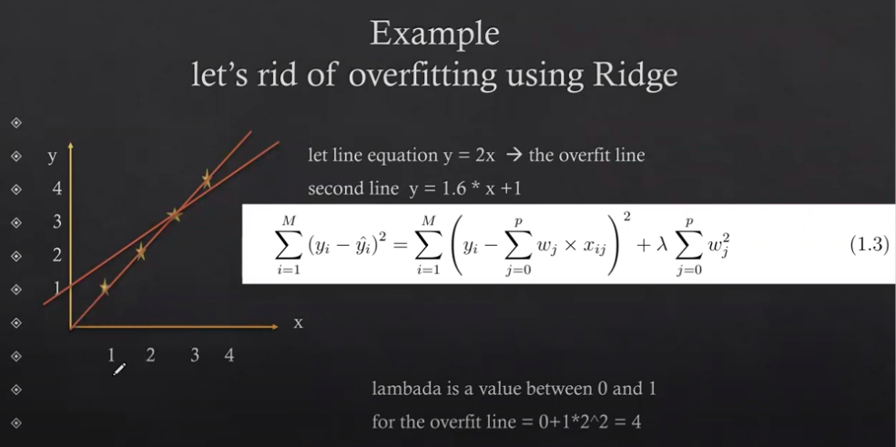

Slide 24
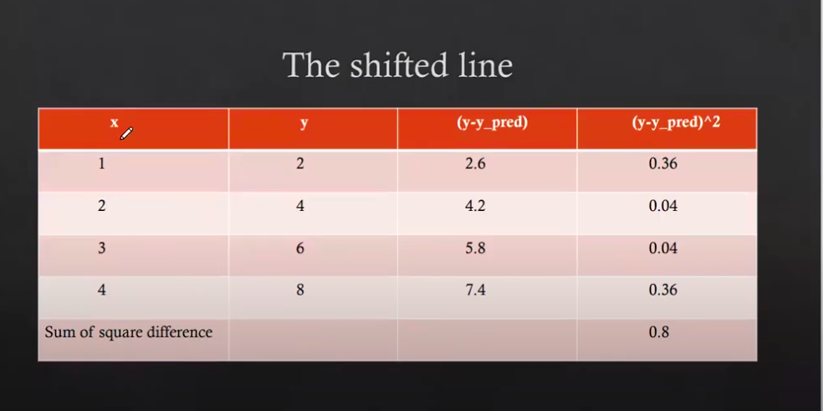

Slide 25
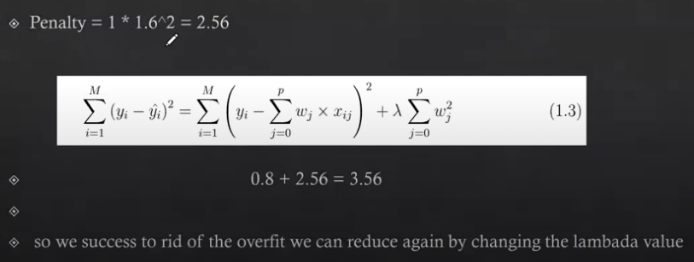

Slide 26
Techniques to Prevent Underfitting
Increasing Model Complexity: Adding more features or parameters
Removing Bias: Ensuring the data is representative
Increasing Training Time: Allowing the model to learn longer
Hyperparameter Tuning: Finding the best parameters

